Slide 1
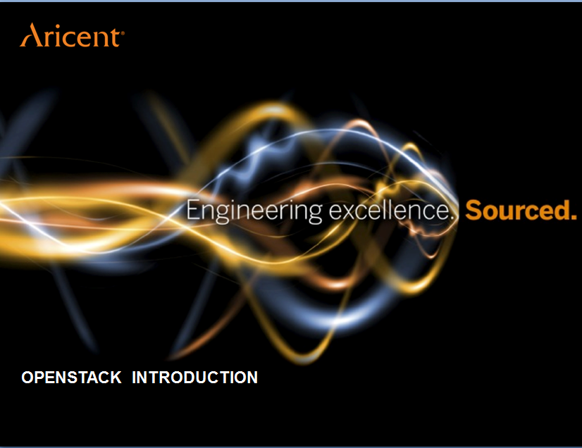

Slide 2
AGENDA
Basics of Cloud Computing and Virtualization
Overview of OpenStack
Architecture of OpenStack
Components of OpenStack
Call Flow for provisioning an instance

Slide 3
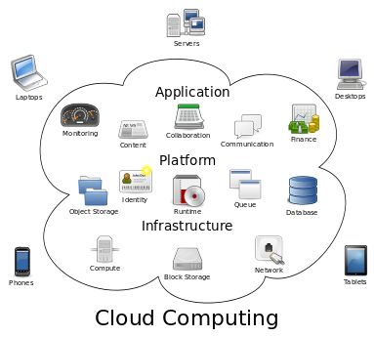
CLOUD COMPUTING
Cloud computing is a general term for anything that involves delivering hosted services over the Internet.
Benefits of Cloud Computing:
Self-service provisioning
Elasticity
Pay per use
Sharing of Resources
Cloud computing enables companies to consume compute resources as a utility -- just like electricity -- rather than having to build and maintain computing infrastructures in-house.

Slide 4
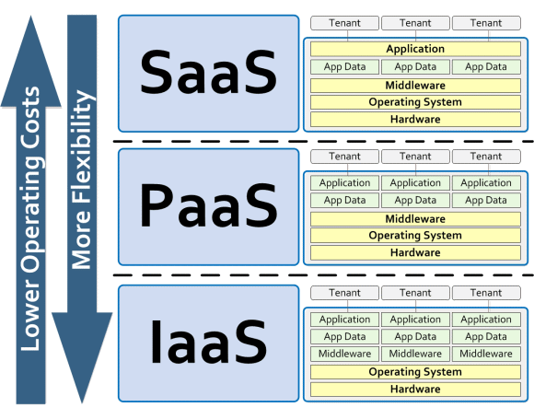
CLOUD SERVICE MODELS

Slide 5
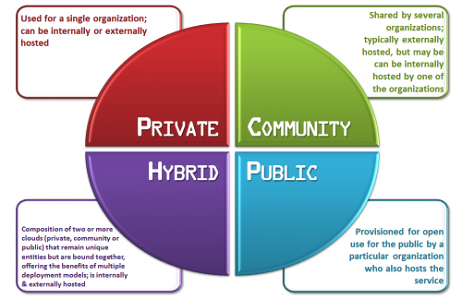
TYPES OF CLOUDS

Slide 6
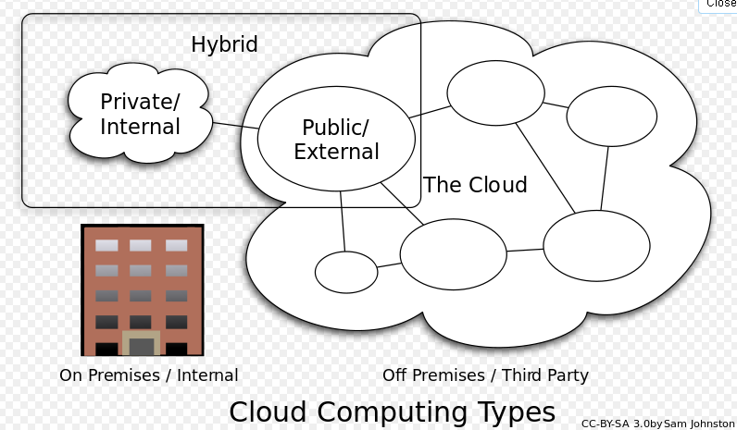

Slide 7
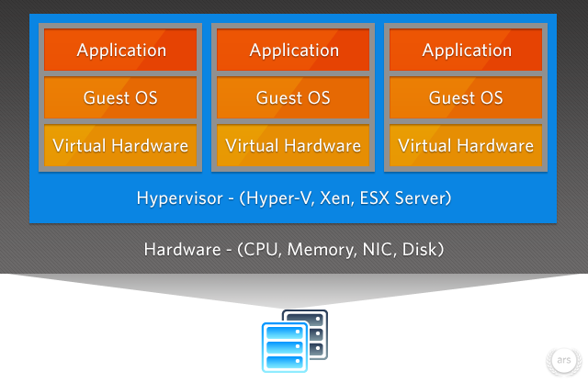
VIRTUALIZATION
Virtualization is the creation of a virtual version of something, such as an operating system, a server, a storage device or network resources.
Benefits:
Up to 80 percent greater utilization of every server.
Reductions in hardware requirements.
Capital and operations expenses cut by half.
Robust, affordable, high availability.

Slide 8
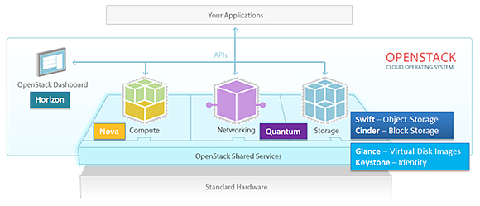
OPENSTACK
OpenStack is a free and open-source cloud computing software platform.
Users primarily deploy it as an infrastructure as a service(IaaS) solution.
OpenStack software controls large pools of compute, storage, and networking resources throughout a datacenter, managed through a dashboard or via the OpenStack API.

Slide 9
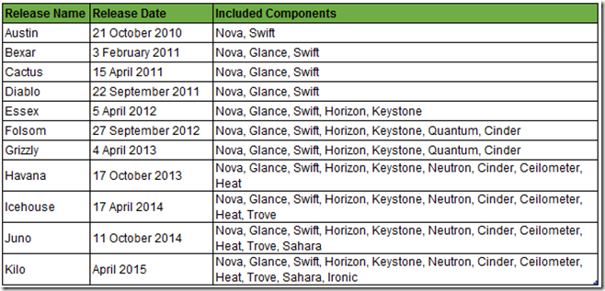
OPENSTACK RELEASES

Slide 10
COMPONENTS OF OPENSTACK
Dashboard(Horizon)
Block Storage (Cinder)
Object Storage (Swift)
Metering (Ceilometer)
Orchestration (Heat)
Compute(Nova)
Identity(Keystone)
Networking(Neutron)
Image Services(Glance)

Slide 11
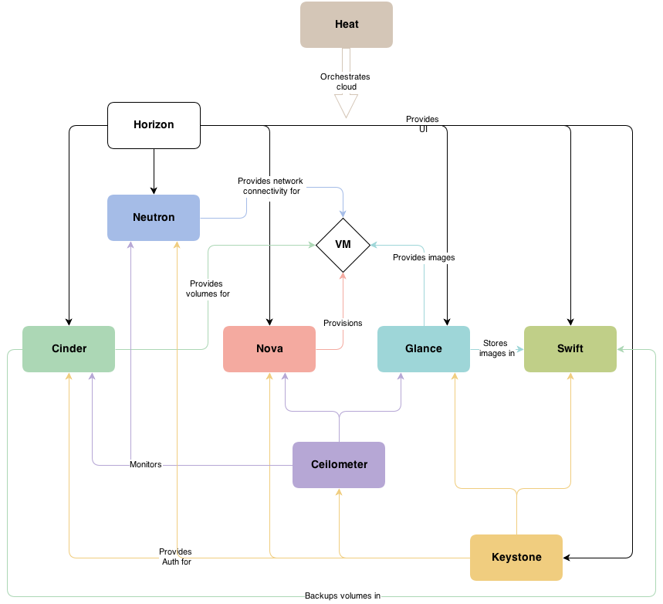
ARCHITECTURE

Slide 12
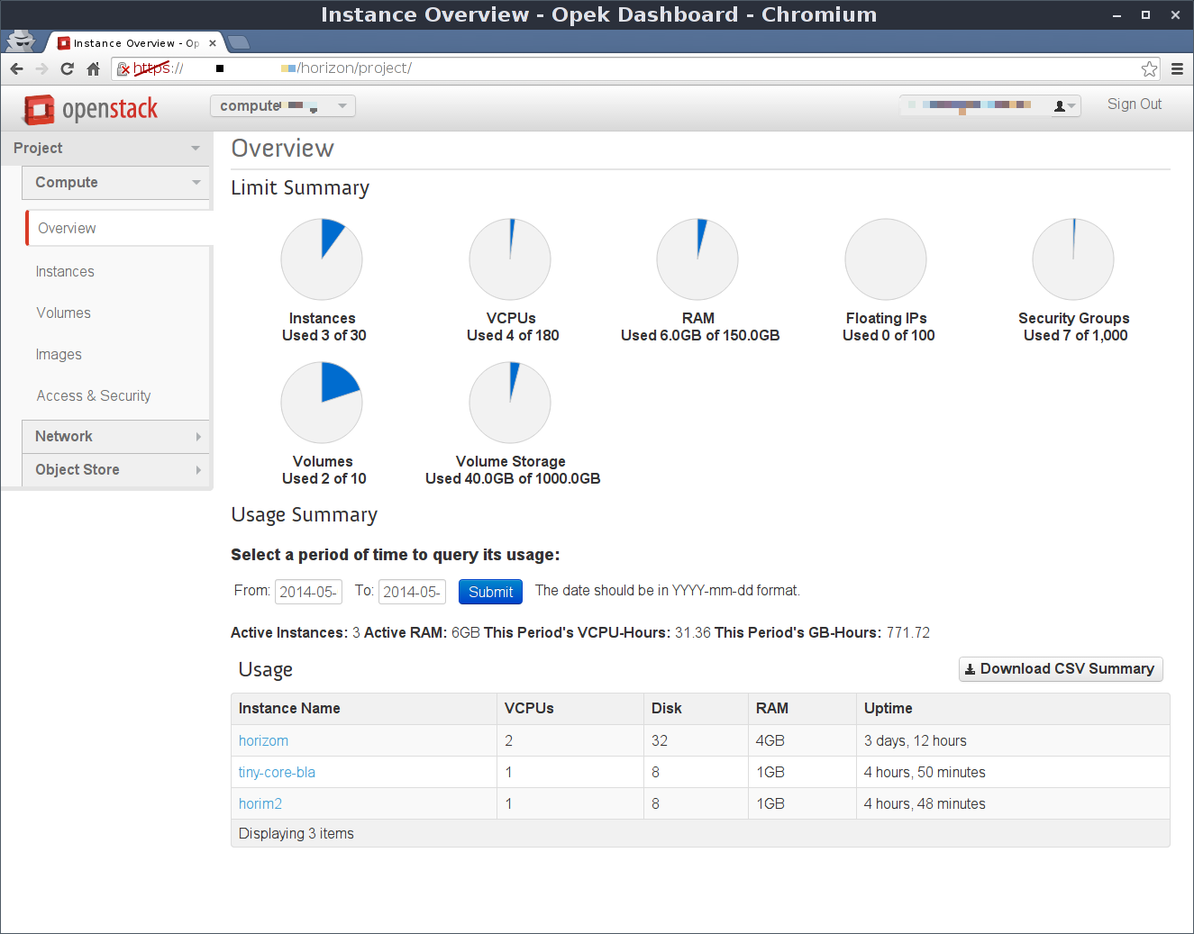
HORIZON-Dashoard
A Web application that runs on Apache.
A Web-based user interface that enables cloud administrators and users to manage various OpenStack resources and services.
As a cloud administrator, the dashboard provides an overall view of the size and state of your cloud.
Enables web-based interactions with the OpenStack Compute cloud controller through the OpenStack APIs.

Slide 13
NOVA-Compute
Nova is the primary computing engine behind OpenStack. It is used for deploying and managing large numbers of virtual machines and other instances to handle computing tasks.
Conceptually similar to Amazon EC2
Features:
Built on shared-nothing, message based architecture
Instance life cycle management
Management of compute resources
REST-based API
Scalable
Support for Hypervisor (Xen, KVM, Hyper-V)

Slide 14
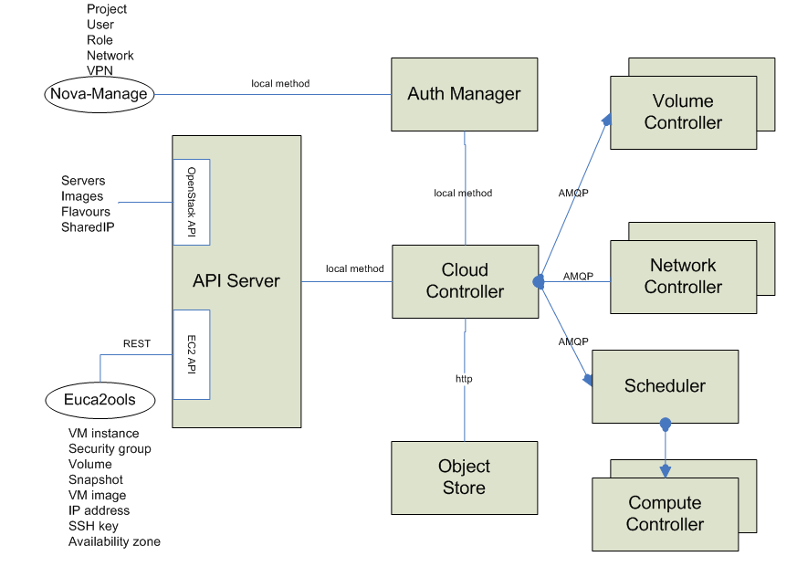
NOVA Architecture

Slide 15
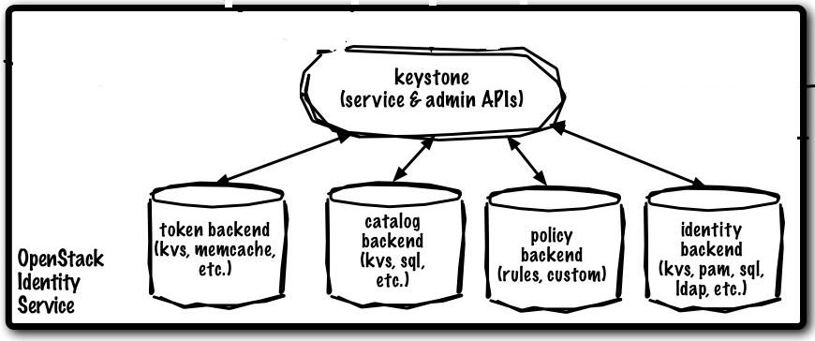
KEYSTONE-Identity
A framework for authentication and authorization for all the OpenStack services.
Handles API requests as well as providing configurable catalog, policy, token and identity services.
As an administrator, OpenStack Identity enables you to:
Configure centralized policies across users and systems.
Create users and tenants and define permissions for compute, storage and networking resources.
As a user, OpenStack Identity enables you to:
Get a list of the services that you can access
Make API requests or log into the web dashboard to create resources owned by your account

Slide 16
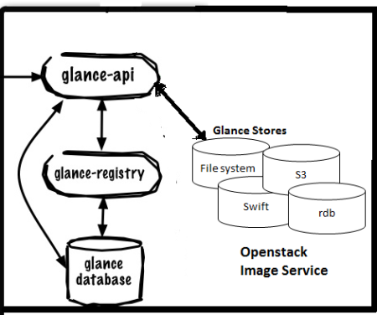
GLANCE-Image
Enables users to discover, register, and retrieve virtual machine images.
It offers a REST API that enables you to query virtual machine image metadata and retrieve an actual image.
The images can be stored in OpenStack Object storage or Block storage.
Components:
glance-api
glance-registry
glance database
storage repository

Slide 17
NEUTRON-Netwoking
Provides ‘Network as a Service’ functionality.
Scalable, pluggable, API-driven system for managing networks and IP addresses.
Allows you to create and attach network deivces managed by other OpenStack services to the network.
Plug-ins and agents for Cisco virtual and physical switches, NEC OpenFlow products, Open vSwitch, Linux bridging, Ryu Network Operating System, and the VMware NSX product.
Components:
Neutron-server
OpenStack Networking Plug-ins and agents
Messaging queue.

Slide 18
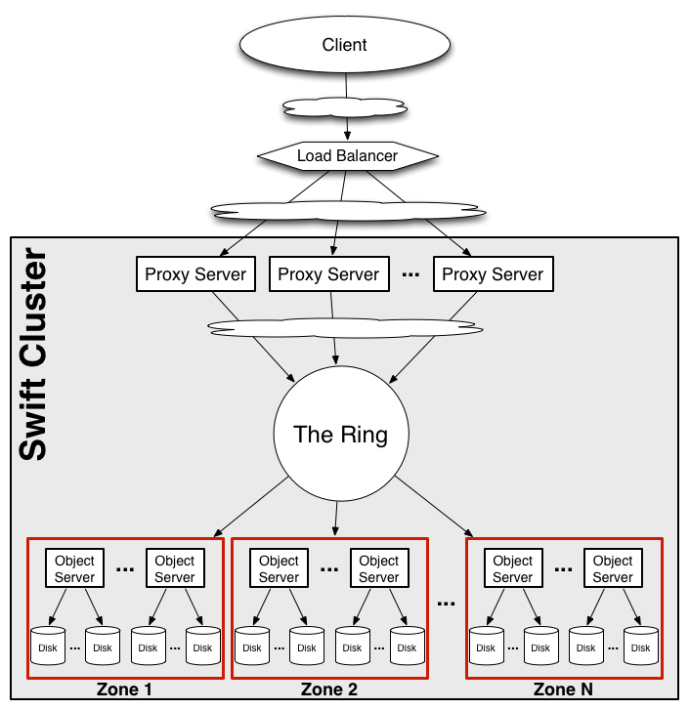
SWIFT-Object Storage
Stores and retrieves arbitrary unstructured data objects via a RESTful, HTTP based API.
Provides distrubuted, eventually consistent virtual object store for OpenStack.
Analogous to AWS-S3
Provides data redundancy and scalability.
Components:
Account
Container
Object
Proxy
Ring

Slide 19
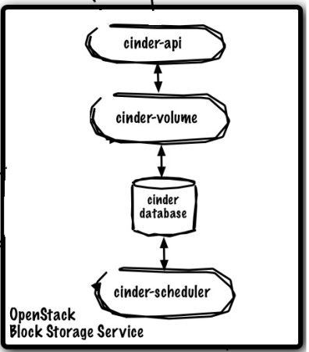
CINDER-Block Storage
Provides ‘Block Storage’ as a service.
Manages the creation, attaching and detaching of the block devices to servers.
Components:
Cinder-API
Cinder-volume
Cinder-database
Cinder-scheduler

Slide 20
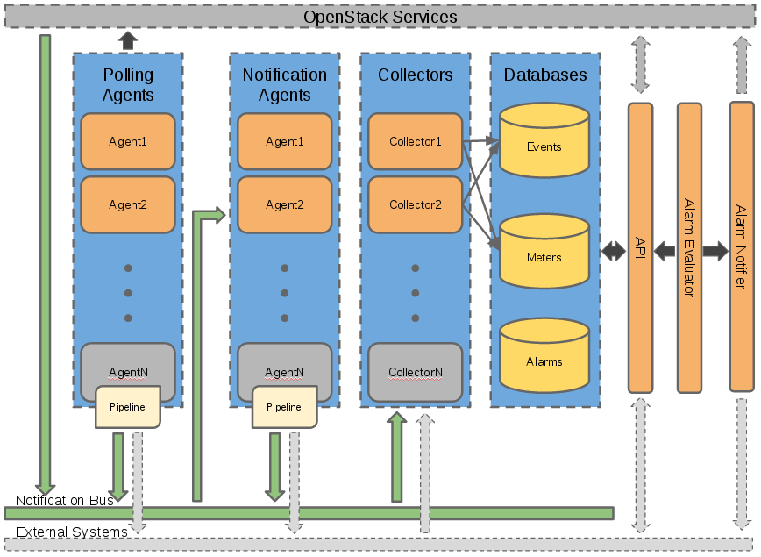
CEILOMETER

Slide 21
The Ceilometer project aims to deliver a unique point of contact for billing systems to acquire all of the measurements they need to establish customer billing, across all current OpenStack core components with work underway to support future OpenStack components.
Ceilometer offers five core services:
Polling agent
Notification agent
Collector
API
Alarming

Slide 22
HEAT
Heat is the main project in the OpenStack Orchestration program.
The mission of the OpenStack Orchestration program is to create a human and machine-accessible service for managing the entire lifecycle of infrastructure and applications within OpenStack clouds.
How it works
A Heat template describes the infrastructure for a cloud application in a text file that is readable and writable by humans.
Infrastructure resources that can be described include: servers, floating ips, volumes, security groups, users, etc.
Templates can also specify the relationships between resources .
Heat manages the whole lifecycle of the application - when you need to change your infrastructure, simply modify the template and use it to update your existing stack

Slide 23
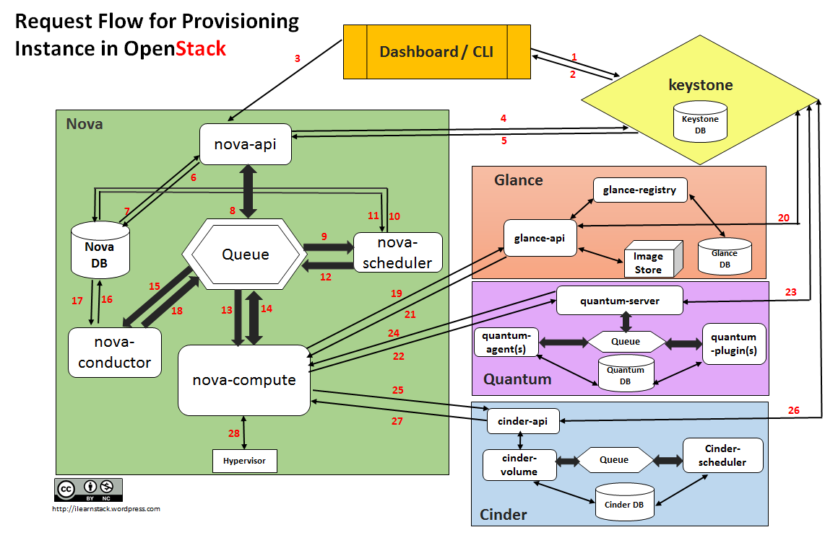
Call Flow for Provisioning an Instance

Slide 24
The request flow for provisioning an Instance goes like this:
Dashboard or CLI gets the user credential and does the REST call to Keystone for authentication.
Keystone authenticate the credentials and generate & send back auth-token which will be used for sending request to other Components through REST-call.
Dashboard or CLI convert the new instance request specified in ‘launch instance’ or ‘nova-boot’ form to REST API request and send it to nova-api.
nova-api receive the request and sends the request for validation auth-token and access permission tokeystone.
Keystone validates the token and sends updated auth headers with roles and permissions.
nova-api interacts with nova-database.
Creates initial db entry for new instance.
nova-api sends the rpc.call request to nova-scheduler excepting to get updated instance entry with host ID specified.
nova-scheduler picks the request from the queue.

Slide 25
nova-scheduler interacts with nova-database to find an appropriate host via filtering and weighing.
Returns the updated instance entry with appropriate host ID after filtering and weighing.
nova-scheduler sends the rpc.cast request to nova-compute for ‘launching instance’ on appropriate host .
nova-compute picks the request from the queue.
nova-compute send the rpc.call request to nova-conductor to fetch the instance information such as host ID and flavor( Ram , CPU ,Disk).
nova-conductor picks the request from the queue.
nova-conductor interacts with nova-database.
Return the instance information.
nova-compute picks the instance information from the queue.
nova-compute does the REST call by passing auth-token to glance-api to get the Image URI by Image ID from glance and upload image from image storage.
glance-api validates the auth-token with keystone.
nova-compute get the image metadata.

Slide 26
nova-compute does the REST-call by passing auth-token to Network API to allocate and configure the network such that instance gets the IP address.
quantum-server validates the auth-token with keystone.
nova-compute get the network info.
nova-compute does the REST call by passing auth-token to Volume API to attach volumes to instance.
cinder-api validates the auth-token with keystone.
nova-compute gets the block storage info.
nova-compute generates data for hypervisor driver and executes request on Hypervisor( via libvirt or api).

Slide 27
REFERENCES
http://docs.openstack.org

Slide 28

Thank you.
Headquarters
303 Twin Dolphin Drive 6th Floor Redwood City, CA 94065 USA
Tel: +1 650 632 4310 Fax: +1 650 551 9901
APAC HQ
Plot 31, Electronic City Sector 18 Gurgaon, Haryana 122015 India
Tel: +91 124 4095888 Fax: +91 124 2455100
Europe HQ
Intec 4, Wade Road, Basingstoke, Hampshire RG24 8NE, United Kingdom
Tel: +44 1256 339500

